Slide 1
Iowa Liquor Sales
Nancy Tran
Notes:
In order to figure out what we should focus in, let’s look at the data.

Slide 2
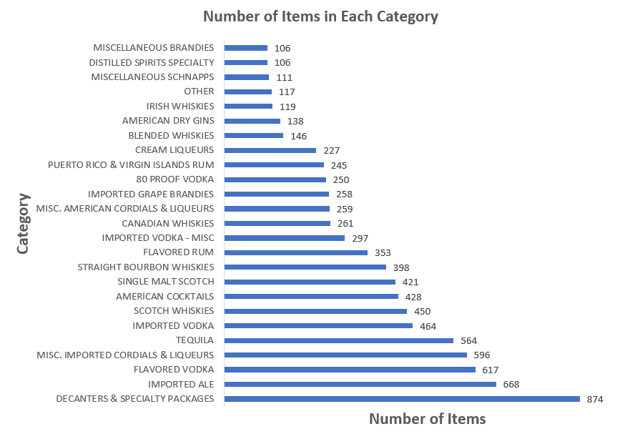
How many total products are in the table? How many products with over 100 counts are in each category?
There are a total of 9,977 products. This graph represents the count of items in each category, filtering it by having the count of number of over 100 items.
Notes:
I’ve chosen the categories that has over 100 items because the chart would be too much if I tried to figure out all of the counts in each category. Plus we want to look at the ones we want to focus on.
DeCanters & Specialty Packages category have the highest number of products in their category of 874 items. Comparing this to Imported Ale category, it seems like a big jump.
We could see that we have 117 items that are considered other, which means it doesn’t have a category where it belongs to.

Slide 3
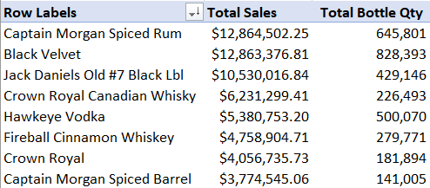
Which products sell the best based on the total sales?
This pivot table shows the top ten products based on the total sales. Notice that Captain Morgan Spiced Rum sold almost 200,000 more bottles than Black Velvet and it sold the best based on total sales.
Notes:
This shows us that we could bring in more of the Black Velvet and less of Captain Morgan Spiced Rum.

Slide 4
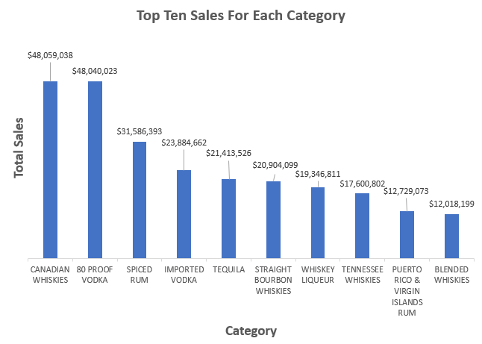
What are the top 10 categories of liquor sold based on the total amount of sales revenue?
We could assume that Canadian Whiskies and 80 Proof Vodka are fighting for the number one category but Canadian Whiskies won by almost $20k

Slide 5
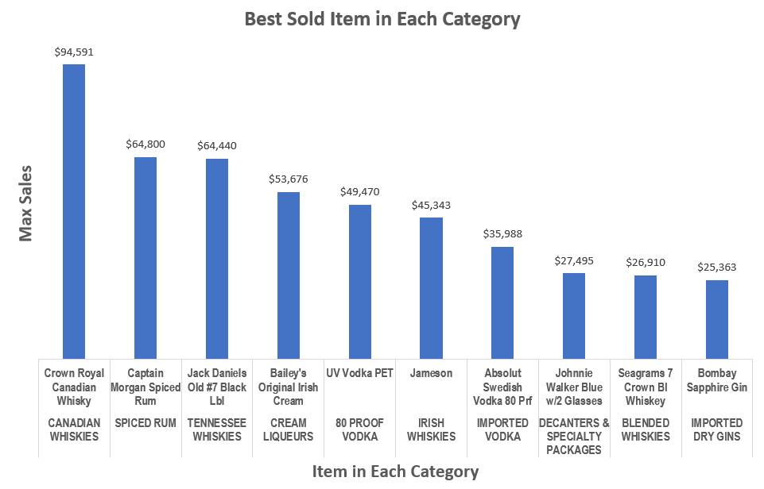
From those top 10 categories, which item from each category sold the best based on the highest sales?
Within the top ten categories from the previous slides, these are the best sold items in each category. Knowing that Canadian Whiskies was the number one category, we could see that Crown Royal sold the best in this category.
Notes:
In the second slide, Crown Royal, Jack Daniels Old#7 Black Label, and Captain Morgan Spiced Rum were also the top 10 items that was sold the best, which means these definitely are some of the items we should focus on.

Slide 6
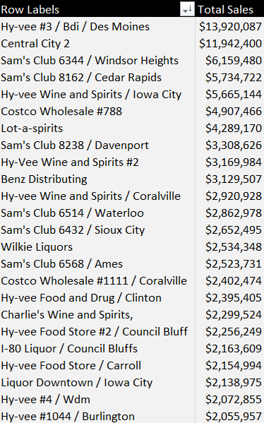
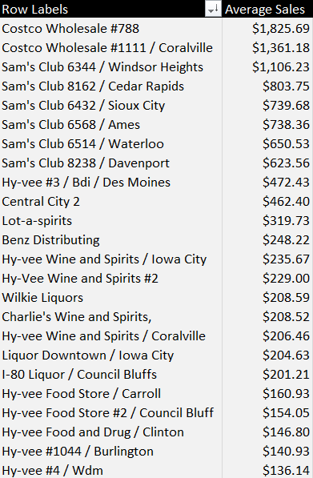
How many stores have more than $2,000,000 in total sales? Based on the stores that have more than $2,000,000 in total sales, which stores should we focus on?
There are 24 stores that have more than $2M in total sales. Basing it off of the top ten for both of the sum and average of the total sales but more focused on the average sales, Costco Wholesale#788, Sam’s Club in Windsor Heights, and Sam’s Club in Cedar Rapids are the top three that seems promising since these stores do well within the total sales and the average sales.

Slide 7
Summary
We have a total of 9,977 products and these products fall into one of the 25 categories.
We would like to focus on products that generates the best sales. Captain Morgan Spiced Rum generated the best sales, yet sold almost 200,000 less bottles than Black Velvet.
The two categories that sold the best compared to the other categories are Canadian Whiskies and 80 Proof Vodka. These are the categories we should focus on.
Crown Royal Canadian Whisky in the Canadian Whiskies category, Jack Daniels Old#7 Black Label in the Tennessee Whiskies category, and Captain Morgan Spiced Rum in the Spiced Rum category had the highest amount of sales, which also appeared in the top ten items that sold the best. This tells us that people are willing to pay a high amount for these items. These are the liquors we should focus on.
There are 24 stores that have over $2M in total sales. The top three stores we should focus on are Costco Wholesales #788, Sam's Club in Windsor Heights, and Sam's Club in Cedar Rapids because these stores do well in both average and total sales.

